Slide 1

Solely for the purpose of Forage Work Experience
Predicting Customer Buying Behaviour

Slide 2
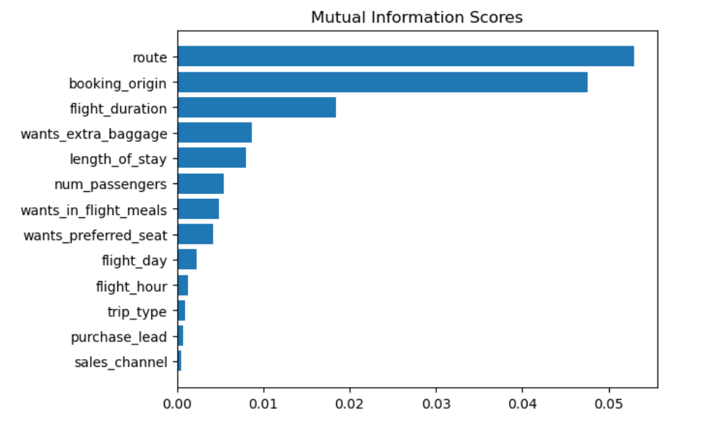
Solely for the purpose of Forage Work Experience
Model to Understand Buying Behaviour
Top 5 Features influencing Buying behaviour:
Route
Booking Origin
Flight Duration
Wants extra Baggage
Length of Stay
We trained data set with Random Forest Classifier model with all the features and received:
Accuracy Score: 85.08
AUC Score: 0.558
We need to increase the AUC score.

